Slide 1
Sales Analysis Report (2011–2015)
Presented By: Ayush Rajput

Slide 2
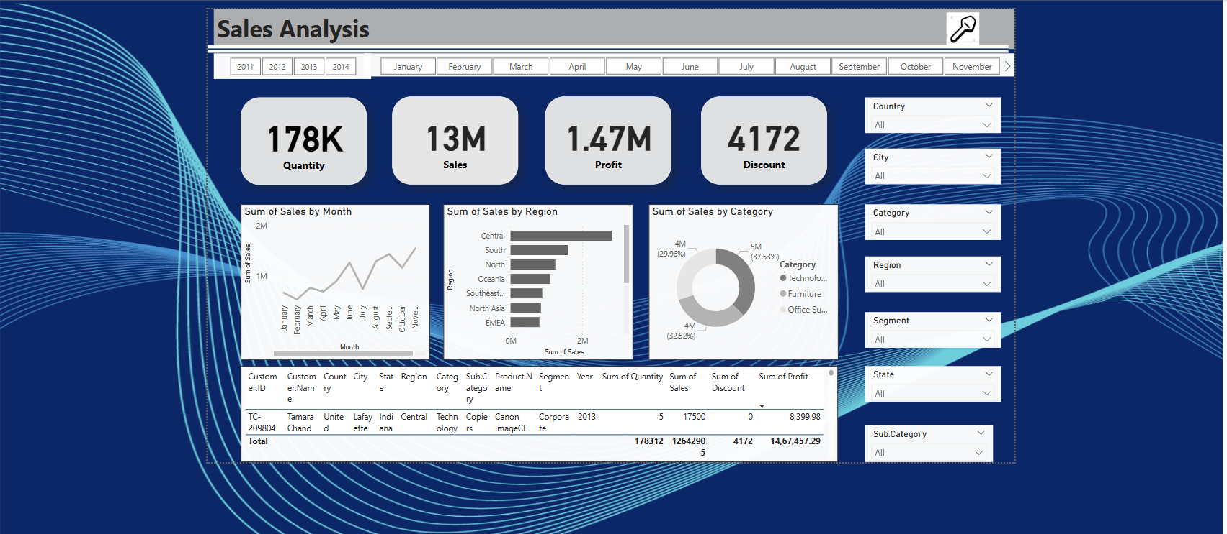

Slide 3
Monthly Sales trend
Sales increase steadily over the year.
August to November shows a noticeable spike in sales.
Likely indicates strong performance in Q3–Q4.

Slide 4
Regional Performance
Top Region: Central – highest sales volume by far.
Followed by: South, North, Oceania, Southeast Asia, North Asia, EMEA.
Central and South regions dominate the market.

Slide 5
Category-wise Sales
Technology: ~37.5% of total sales (~5M)
Furniture: ~32.5% (~4M)
Office Supplies: ~30% (~4M)
Technology category leads, but all three are relatively close.

